Slide 1

Air Quality forecasting: CO2 emissions

Slide 2
Trainer name: Mr.advaith
Group members name:
Mr. Rupesh Prakash Suryawanshi
Mr. Pavan Venkat Kalangi
Ms. Janhavi Atul Jadhav
Mr. Onkar Pramod Joshi

Slide 3
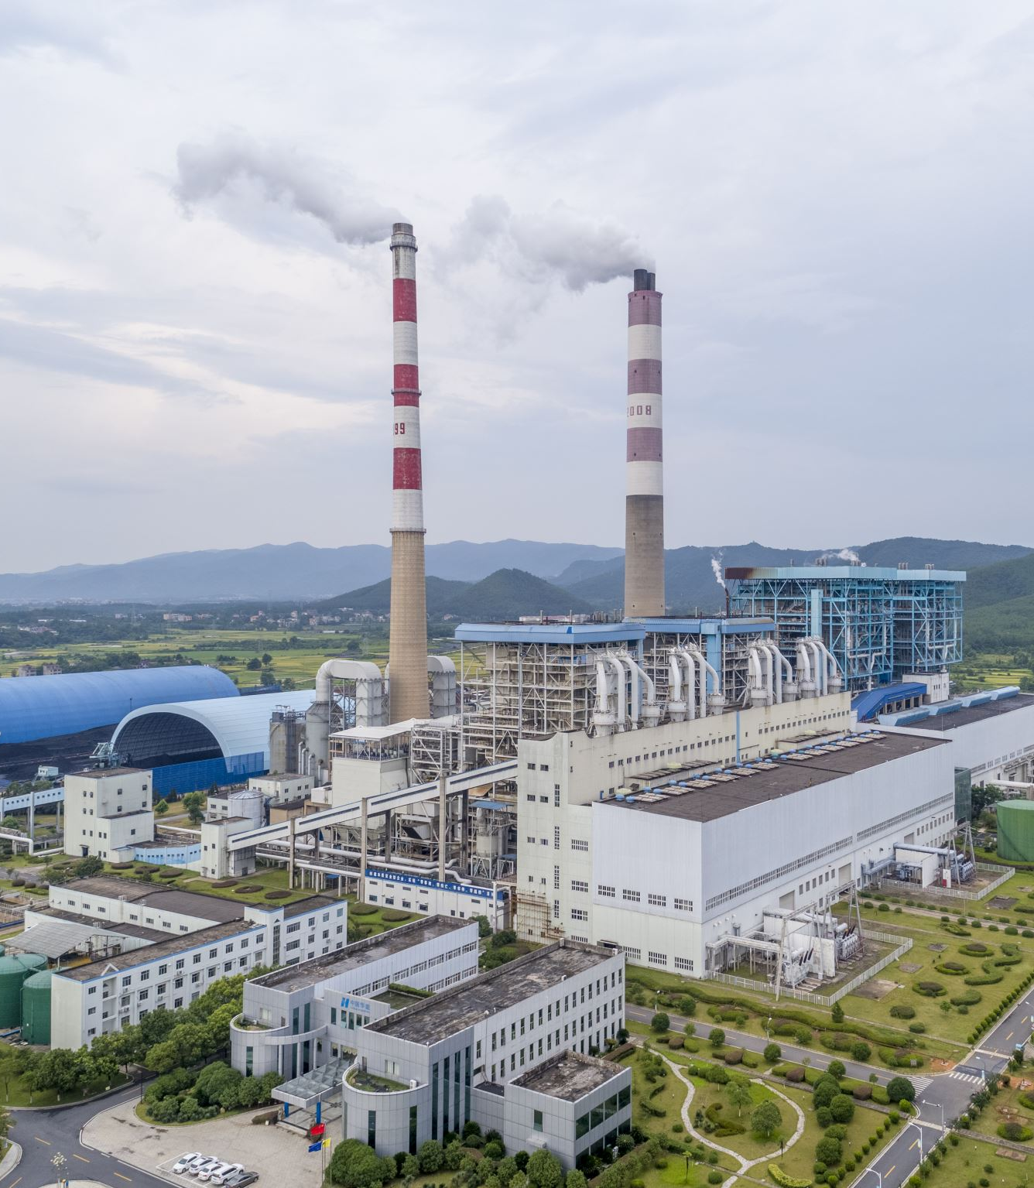
Problem Overview:
From the last century we have seen immense growth in Co2 concentration.
The main causes includes developing industrialism, day by day increasing demand of energy and automobiles.
More concentration of co2 in atmosphere causing adverse effect not only on human life but also on animal and plant life.
So we need to take necessary steps for current situation and we should be prepare for future condition also.
This project will build a model that can correctly forecast upcoming years co2 concentration, so we can take necessary steps accordingly.

Slide 4

Solution process:
Let’s discuss about the Dataset-
The dataset we got having information of co2 emission of last 200 years.
Our goal was to used this information to make upcoming years forecasting.
We start the process with performing exploratory data analysis.

Slide 5
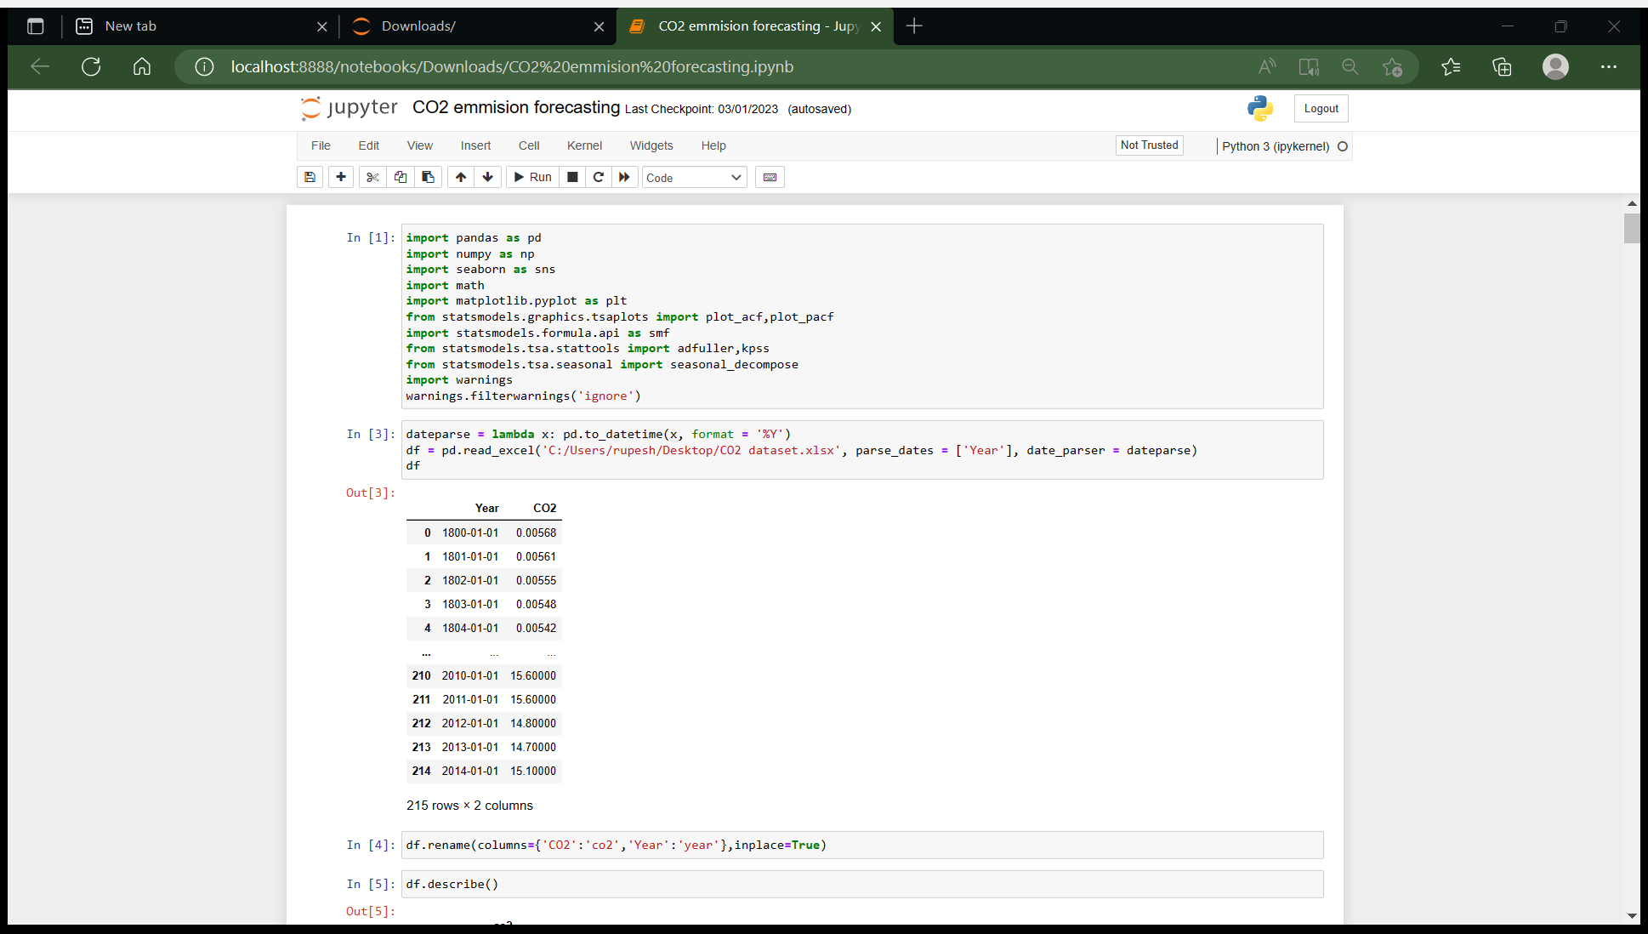
Importing Data
The data we got was not in proper date format, but for performing forecasting we needed data in datetime format.
So, while importing data we change to datetime format using pandas datetime feature.

Slide 6
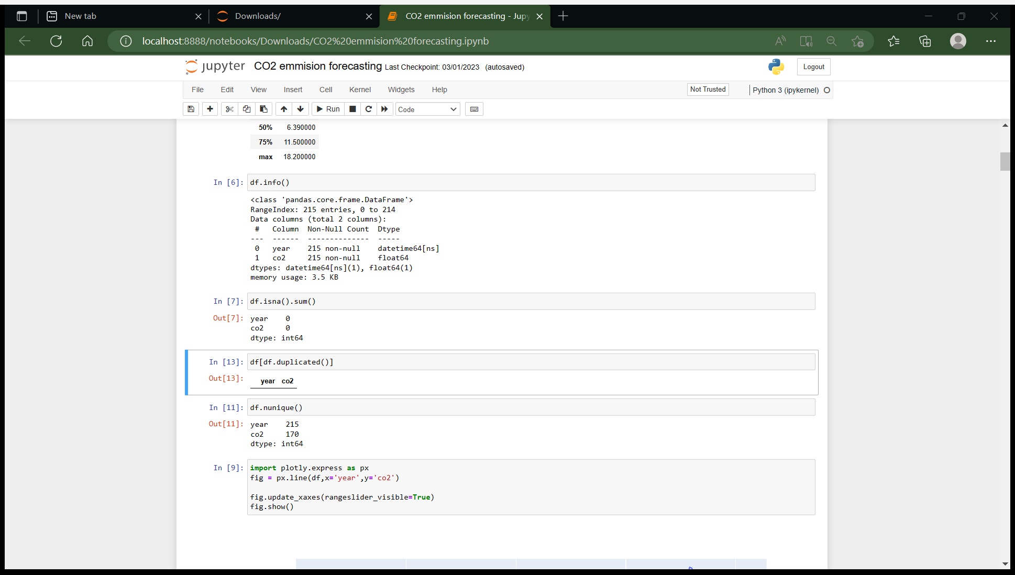
EDA:
We have started with basic EDA like checking for null values, checking duplicate values.
There was no null and duplicate values was present in the data as we can see, so there was no need for treatment.

Slide 7
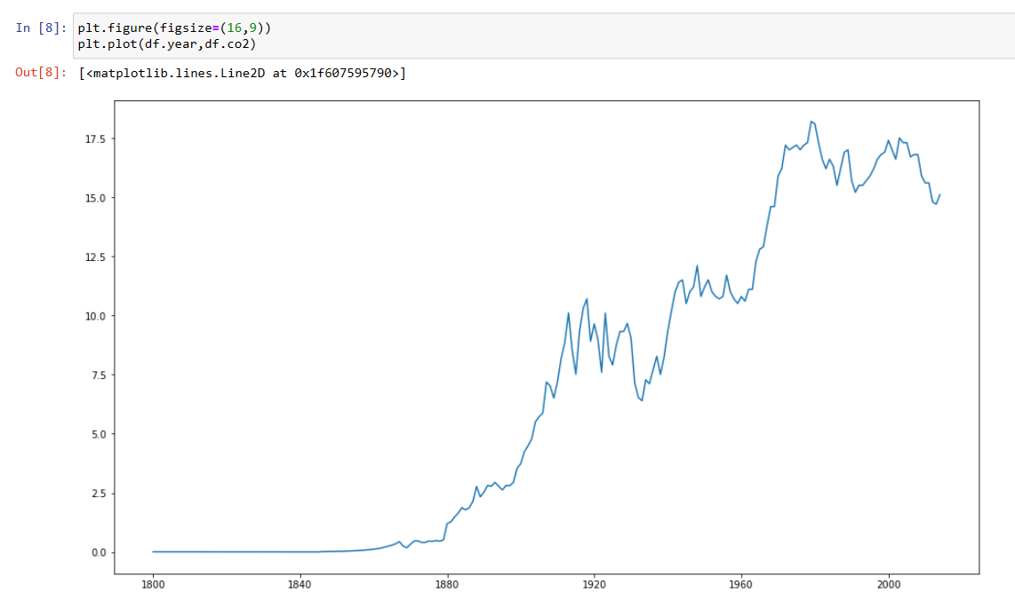
Visualization: 1.line plot
we first plot line plot to see growth of co2 throght the years.

Slide 8
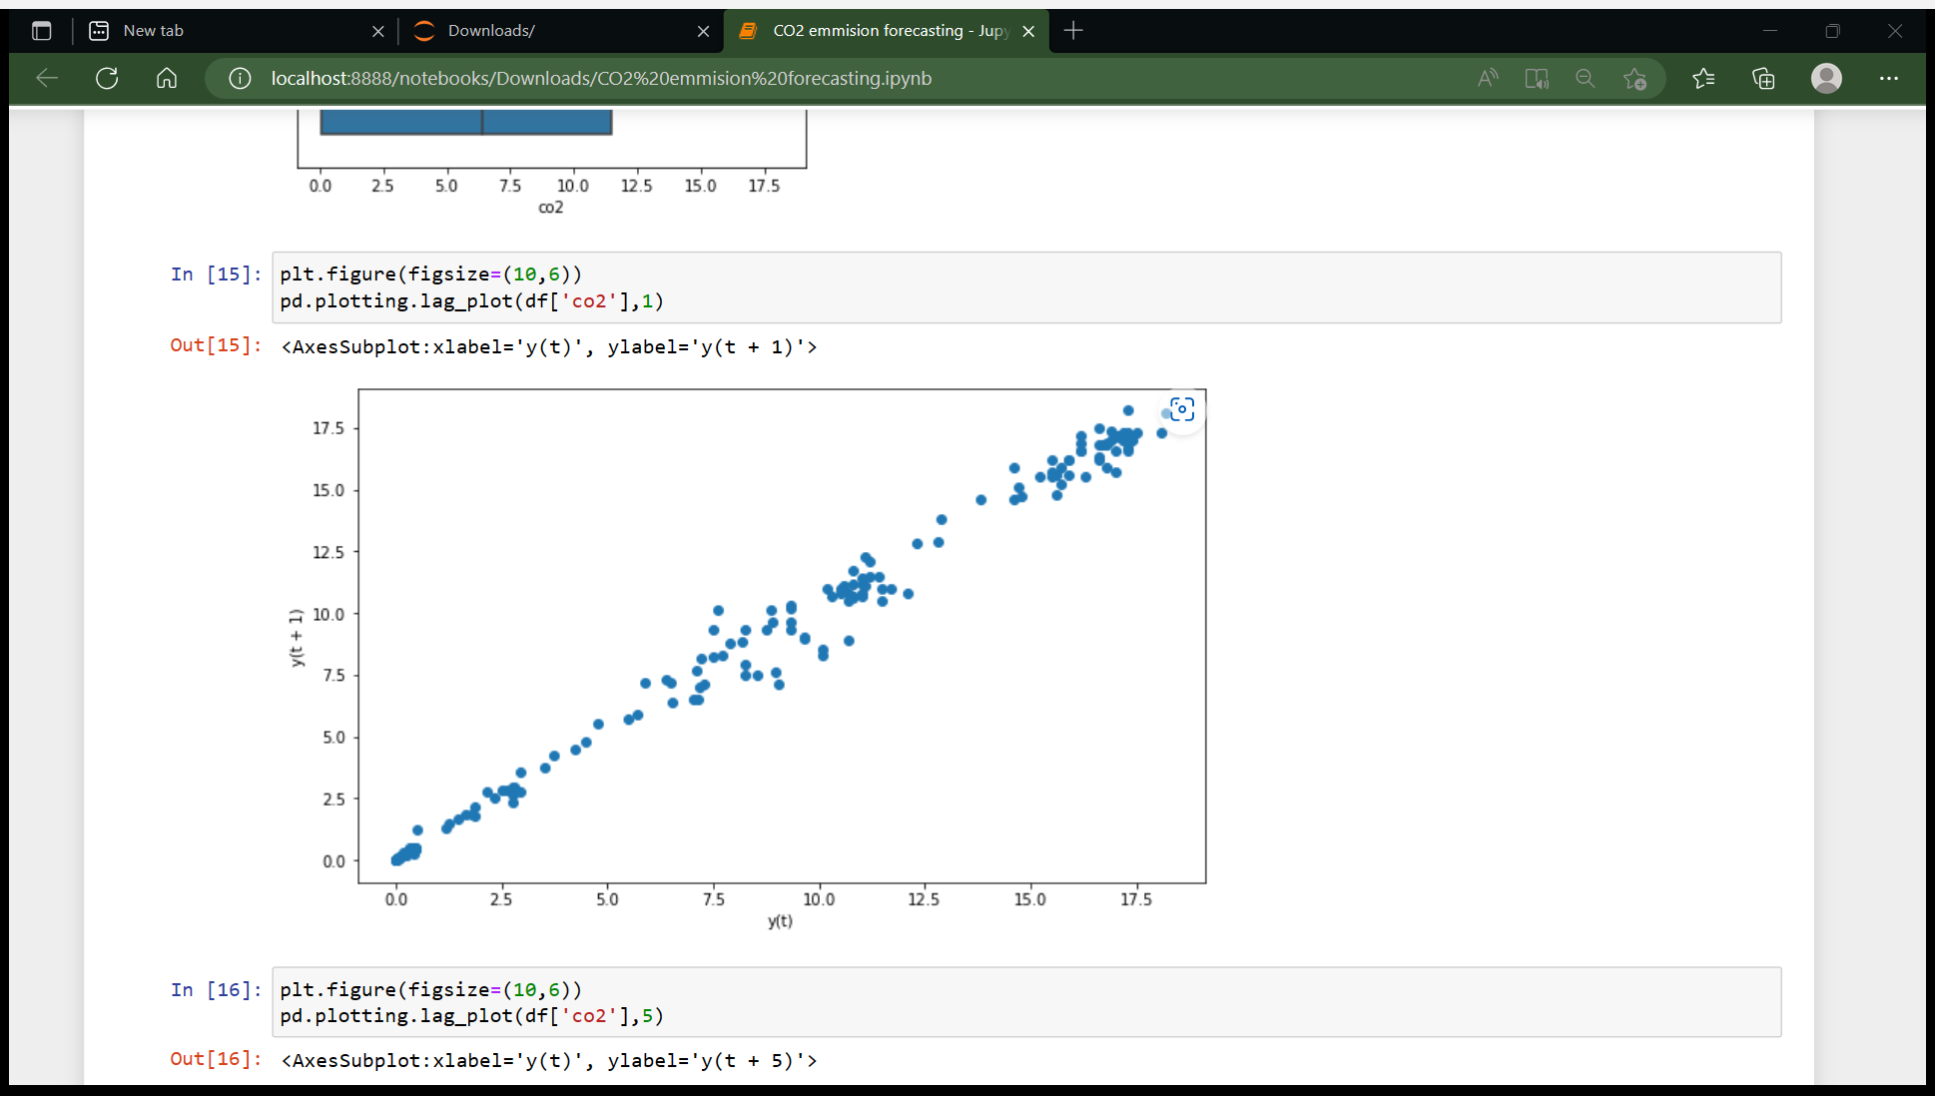
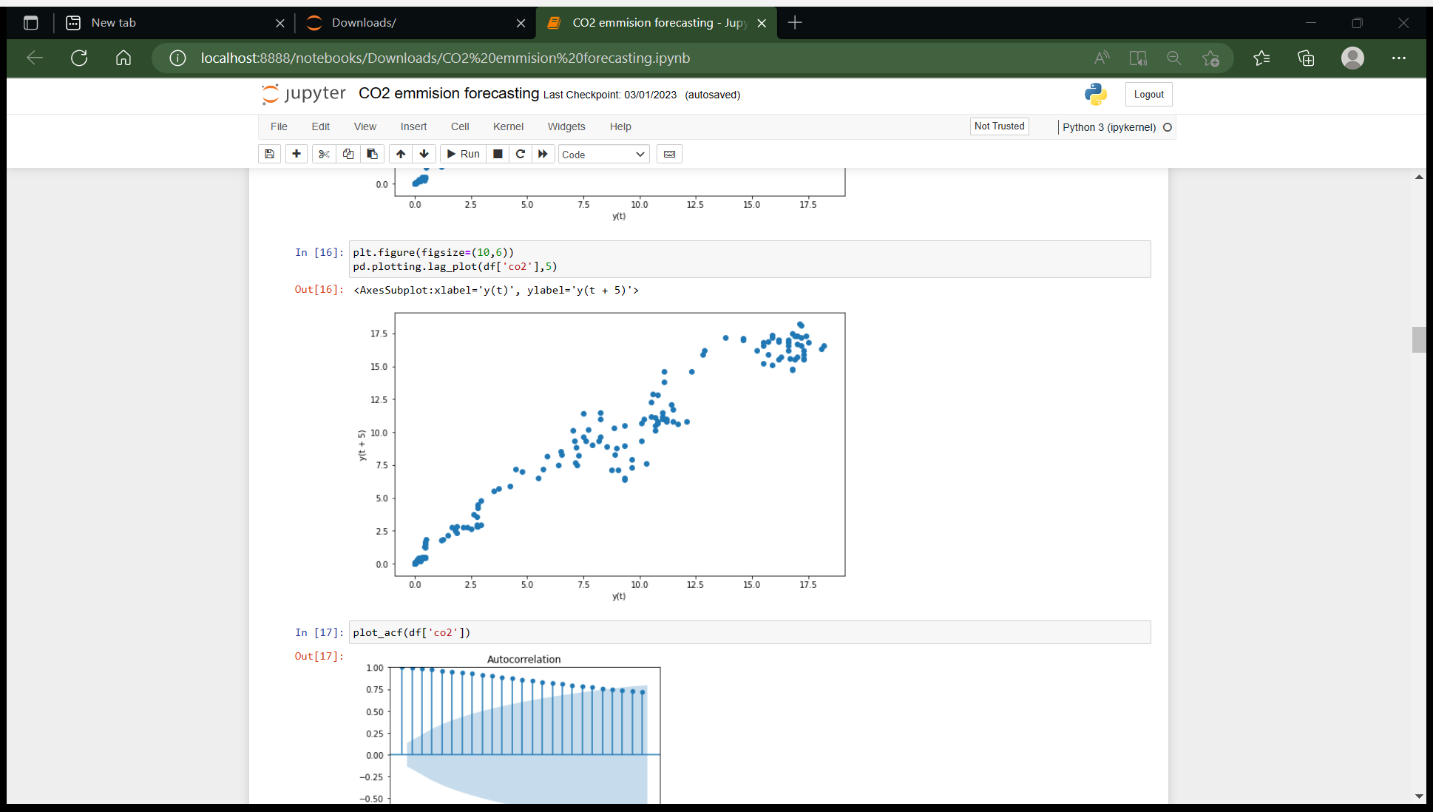
2.Scatter plot
We plot scatter plot of Co2 values with t+1 lag and t+5 lag
Here we can see with lag t+1 it have very good linear relationship.

Slide 9
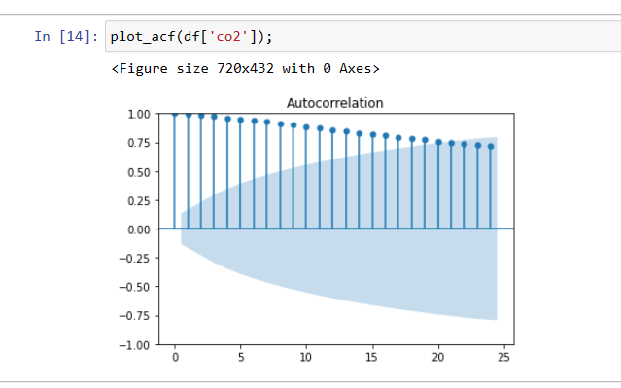
3.Autocorrelation plot:
Autocorrelation plots are a commonly-used tool for checking randomness in a data set. This randomness is ascertained by computing autocorrelations for data values at varying time lags. If random, such autocorrelations should be near zero for any and all time-lag separations. If non-random, then one or more of the autocorrelations will be significantly non-zero.

Slide 10
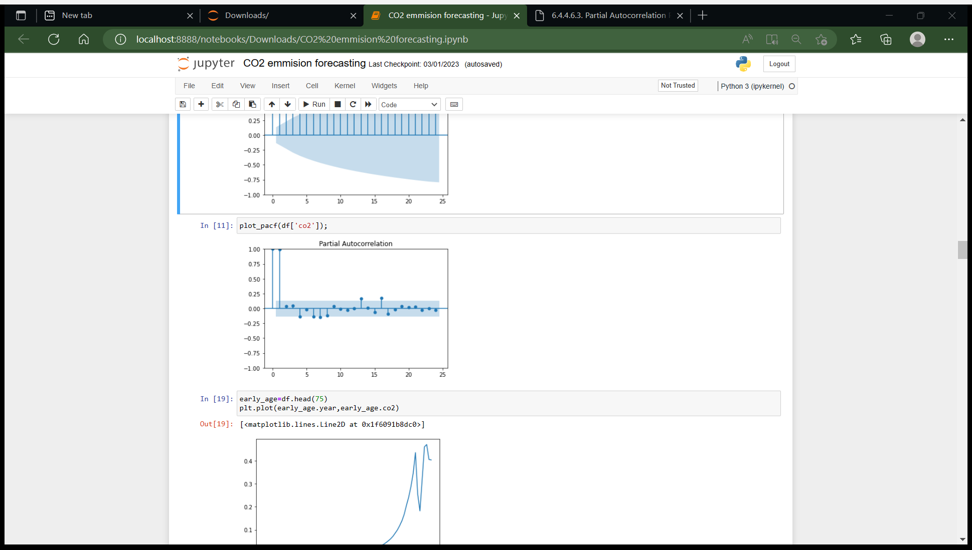
4.Partial autocorrelation plot:
partial autocorrelations are useful in identifying the order of an autoregressive model.

Slide 11
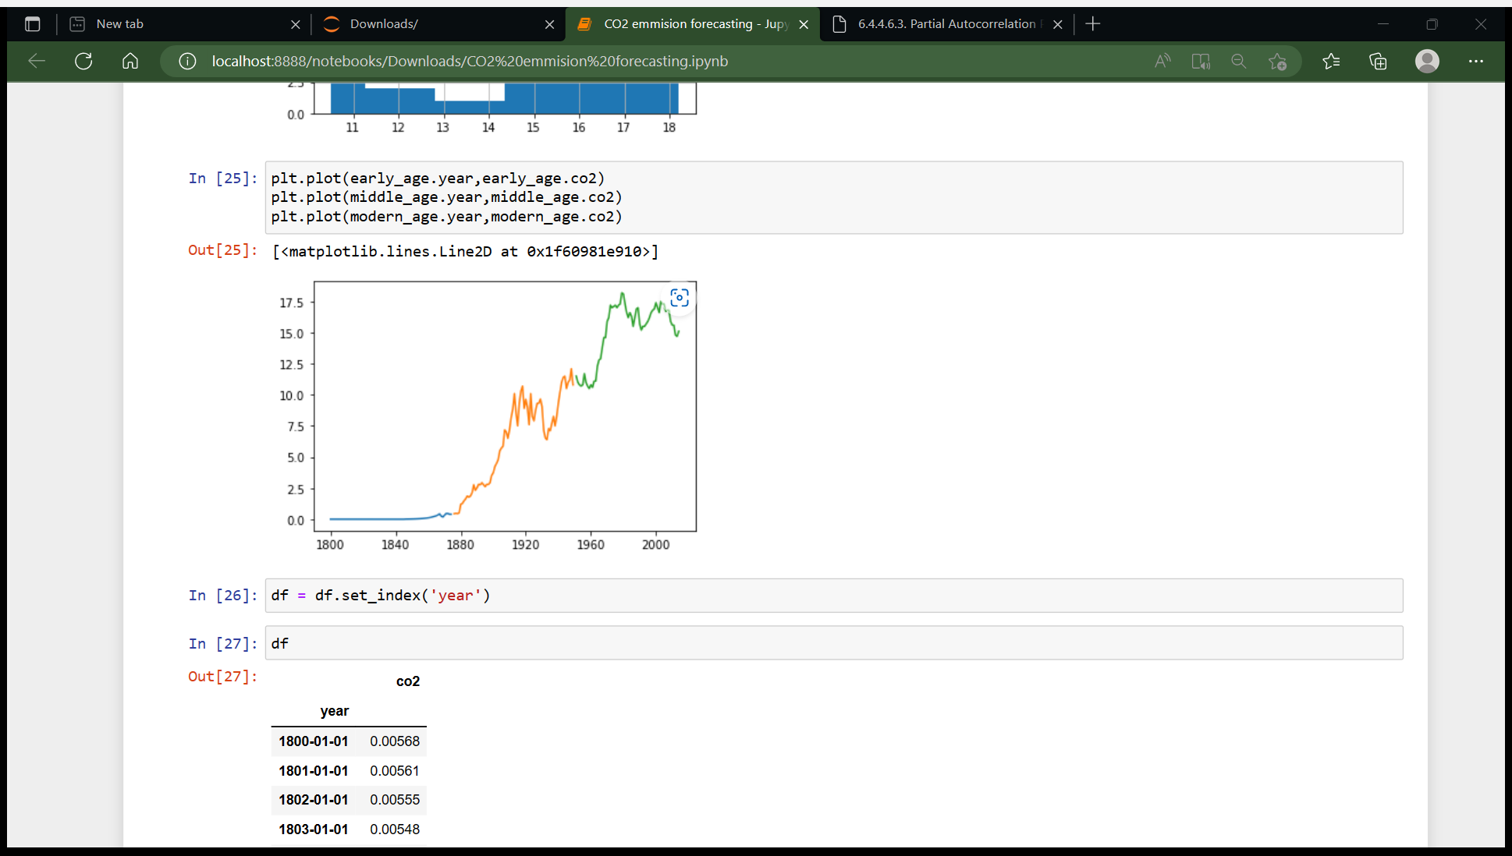
Here we split the dataset into three parts in the interval of 75 years.
We see that from 1880 the Co2 emission was started increasing.
In 1940 it comes down because of war situation.
But after 1960 it again started to increase till date.

Slide 12
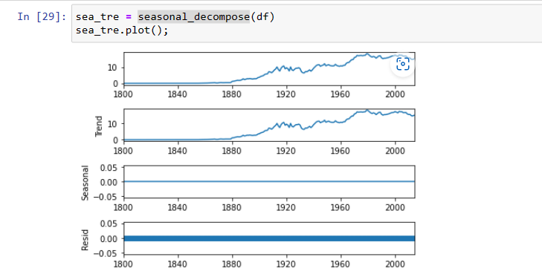
5. Seasonal decompose plot:
This plot shows any trends, seasonality in the data.
We can see that our data has trend but not seasonality.

Slide 13
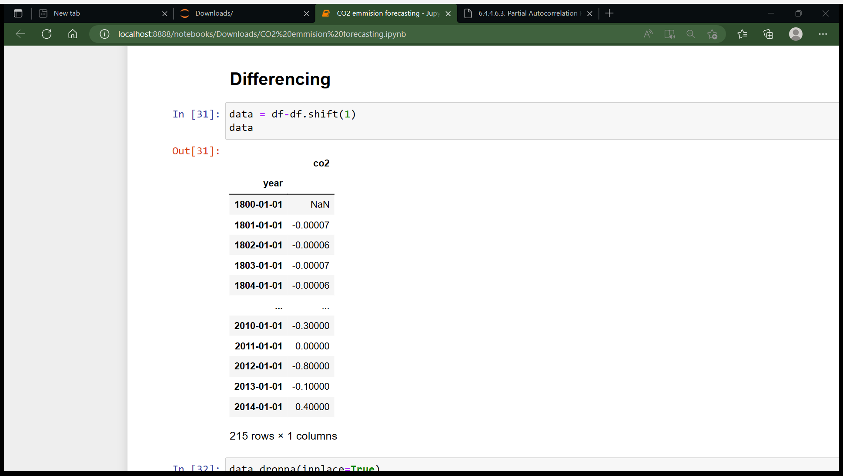
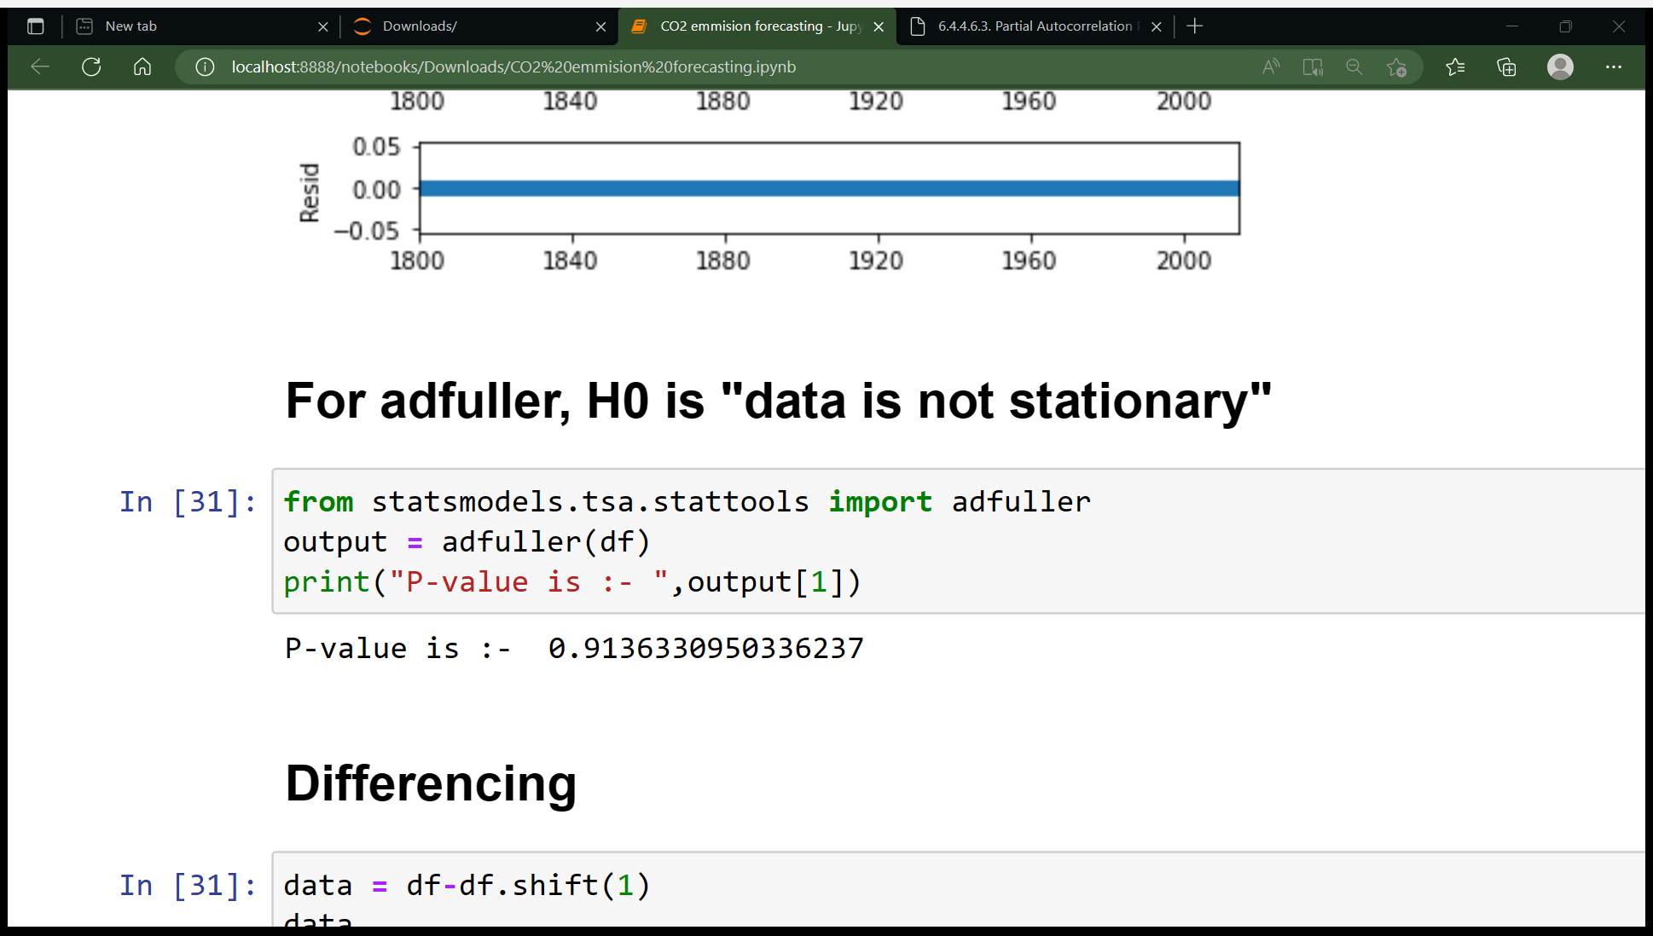
Making data stationary:
We checked that our data is stationary or not, using ad-fuller method, from this we got to know that data is not stationary.
So, we made data stationary using Differencing method.

Slide 14
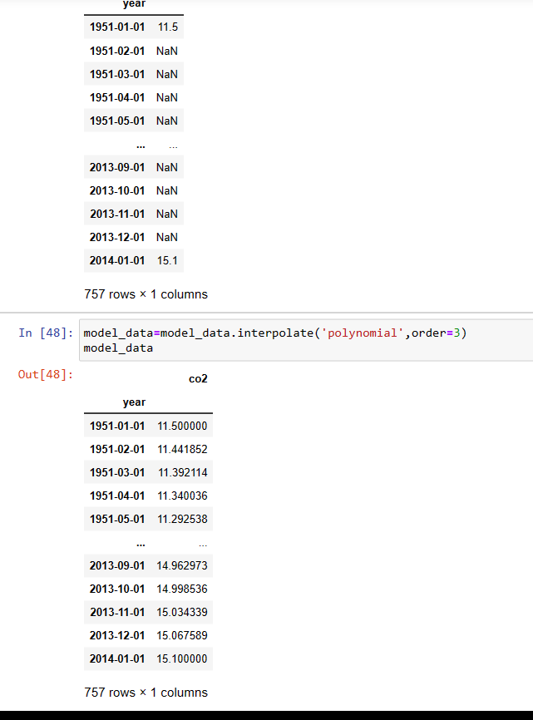
Upsampling:
We upsample data from ‘YYYY’ format to ‘YYYY-MM-DD’ format and interpolate value.

Slide 15
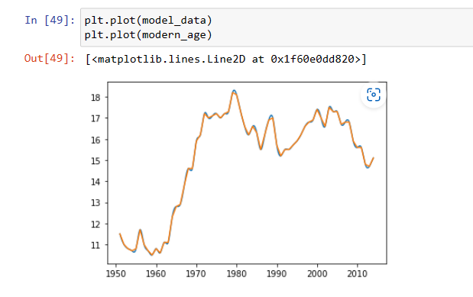
Here we can see the actual data and upsampled interpolated data fits accurately.

Slide 16
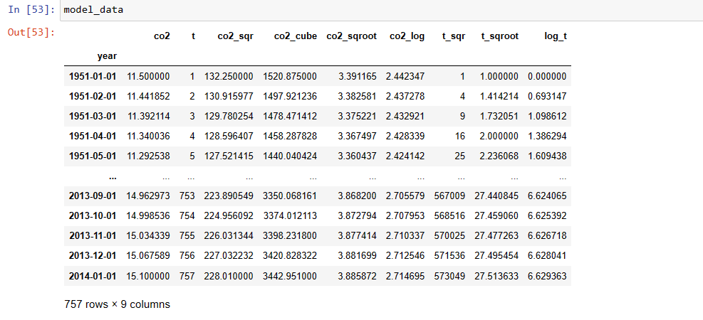
Data transformation:
We perform some transformation on data like square ,square root, log, cub etc.

Slide 17

Analytical Approach:
As this a forecasting model, we perform some time series model:
1) Linear model
2) Exponential model
3) Quadratic model
4) Holts Model
5) Holts winter models
6) Arima model

Slide 18
Model Preparation and Validation:
We train the models on training data and predict on the test data.
We took 80% data for training and remaining 20% for testing
Some of the models give good result like Linear, Holts, Arima.

Slide 19
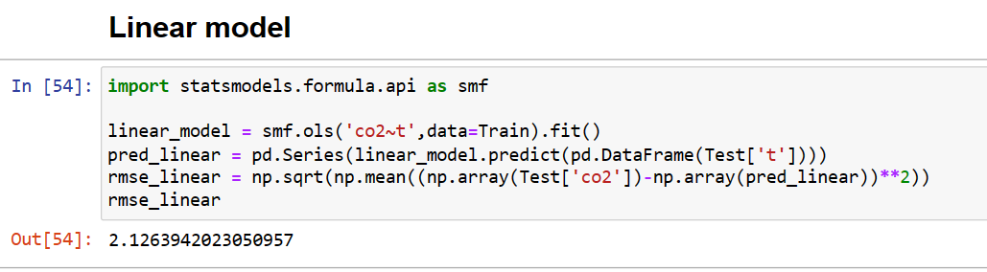
1. Linear model:
Linear models RMSE of 2.126

Slide 20
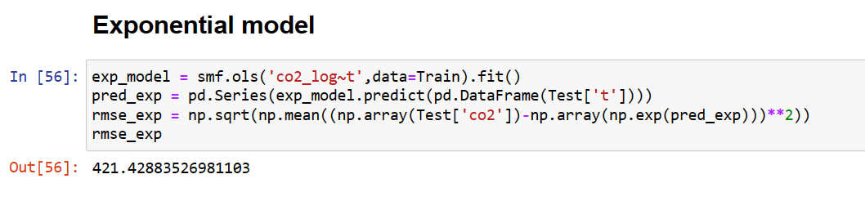
2.Exponential model:
Exponential model gives RMSE of 421.82

Slide 21
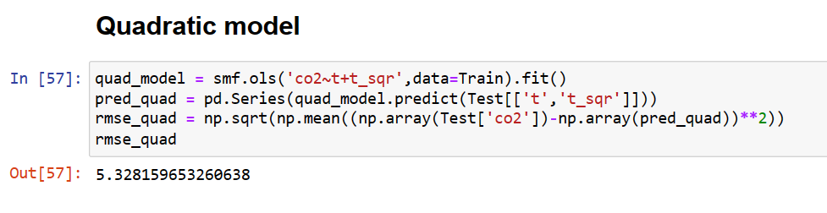
3. Quadratic Model:
Quadratic Model give RMSE of 5.328

Slide 22
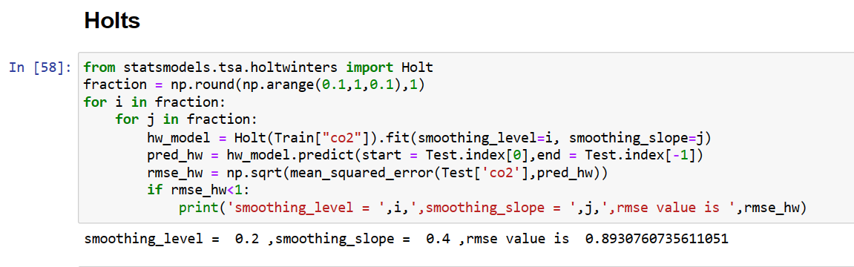
4. Holts Model:
Holts Model gives RMSE of 0.893

Slide 23
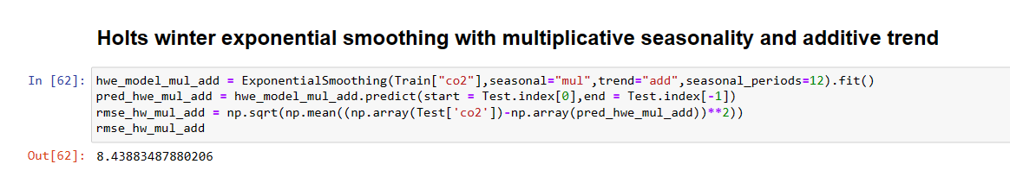
5. Holts winter model with multiplicative seasonality and additive trend :
Holts winter model with multiplicative seasonality and additive trend give RMSE of 8.438

Slide 24
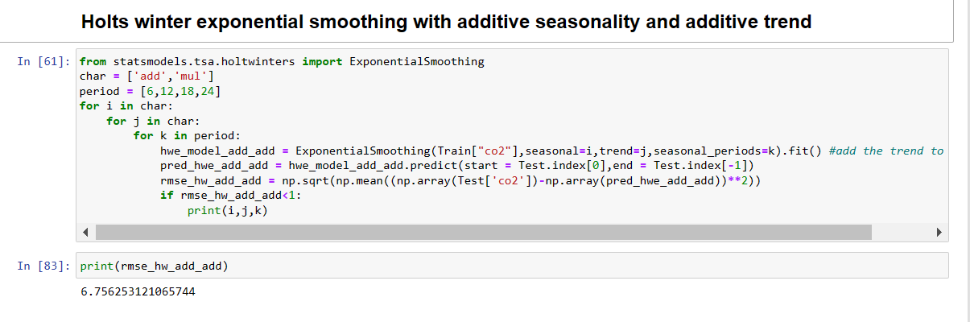
6. Holts winter exponential smoothing with additive seasonality and additive trend :
Holts winter model with additive seasonality and additive trend give RMSE of 6.756.

Slide 25
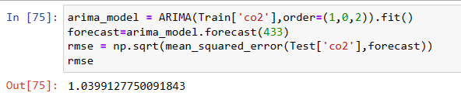
7.Arima Model:
Arima model gives RMSE of 1.039

Slide 26
Model comparison:
Models | RMSE
Linear Model | 2.126
Exponential Model | 421.82
Quadratic Model | 5.328
Holts Model | 0.893
Holts winter model with multiplicative seasonality and additive trend | 8.438
Holts winter exponential smoothing with additive seasonality and additive trend | 6.756
Arima Model | 1.039

Slide 27
Finalizing the Model:
After checking the accuracy of all models we decided to go with the Holts model for the Deployment.
For the deployment we used Streamlit.
We built front end of our website using python and deploy it on our local machine.
For the global deployment we used Render cloud.

Slide 28
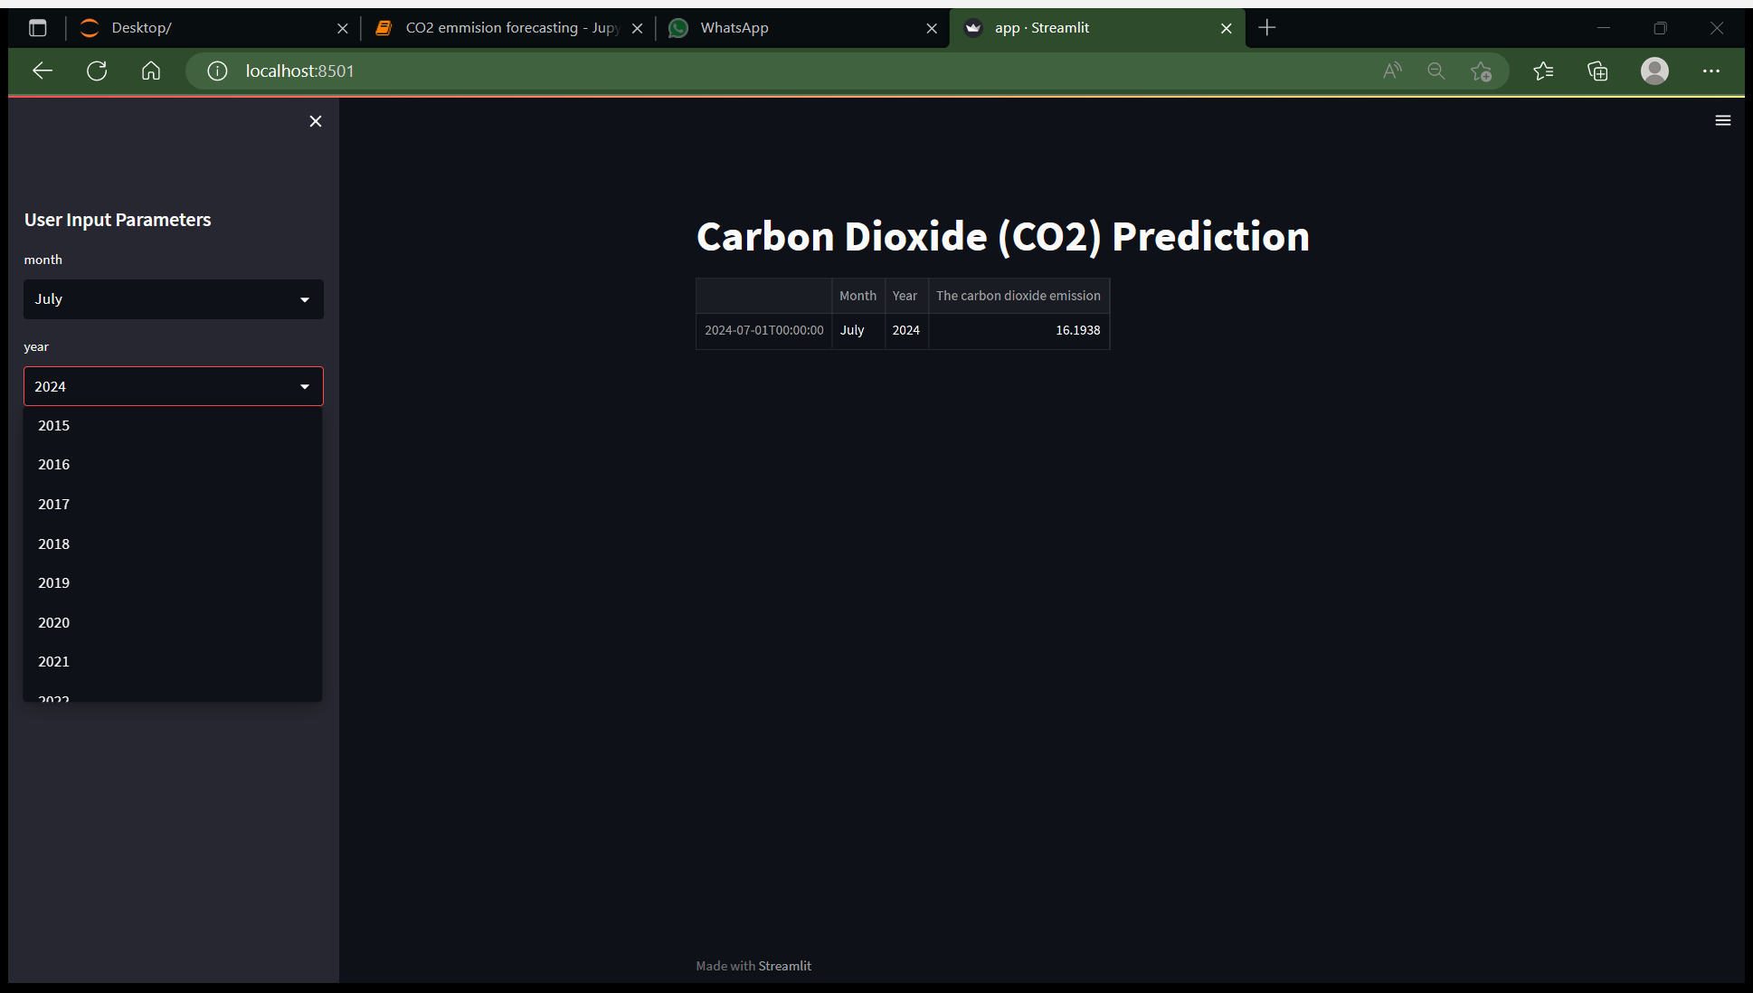

Slide 29

Challenges faced in Project:
The data we got have last 200 years of Co2 emission information, but in the initial years there was no considerable emission.
So we had to split the data in parts to feed the optimum information to model.
There was trend in our data so we had to use differencing to remove trend effect.

Slide 30

Thank You

